Slide 1

Understanding Microplastics and
Visual Art as a Method of Communication

Slide 2
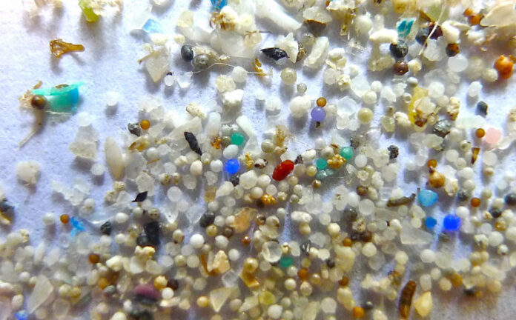
Microplastics
Microplastics are fragments of plastics below 5cm. They persist throughout the biosphere. (Ahmet et al, 2018).
They can be presorbed by mammalian guts (Jani, 1992)
Present within household dust and everyday items.
Some plastics have potential to leach harmful chemicals such as BPA, and cause illness (Lithner et al, 2011).
9% of my predominantly educated survey audience have never heard of microplastics.
This Photo by Unknown Author is licensed under CC BY-ND

Slide 3
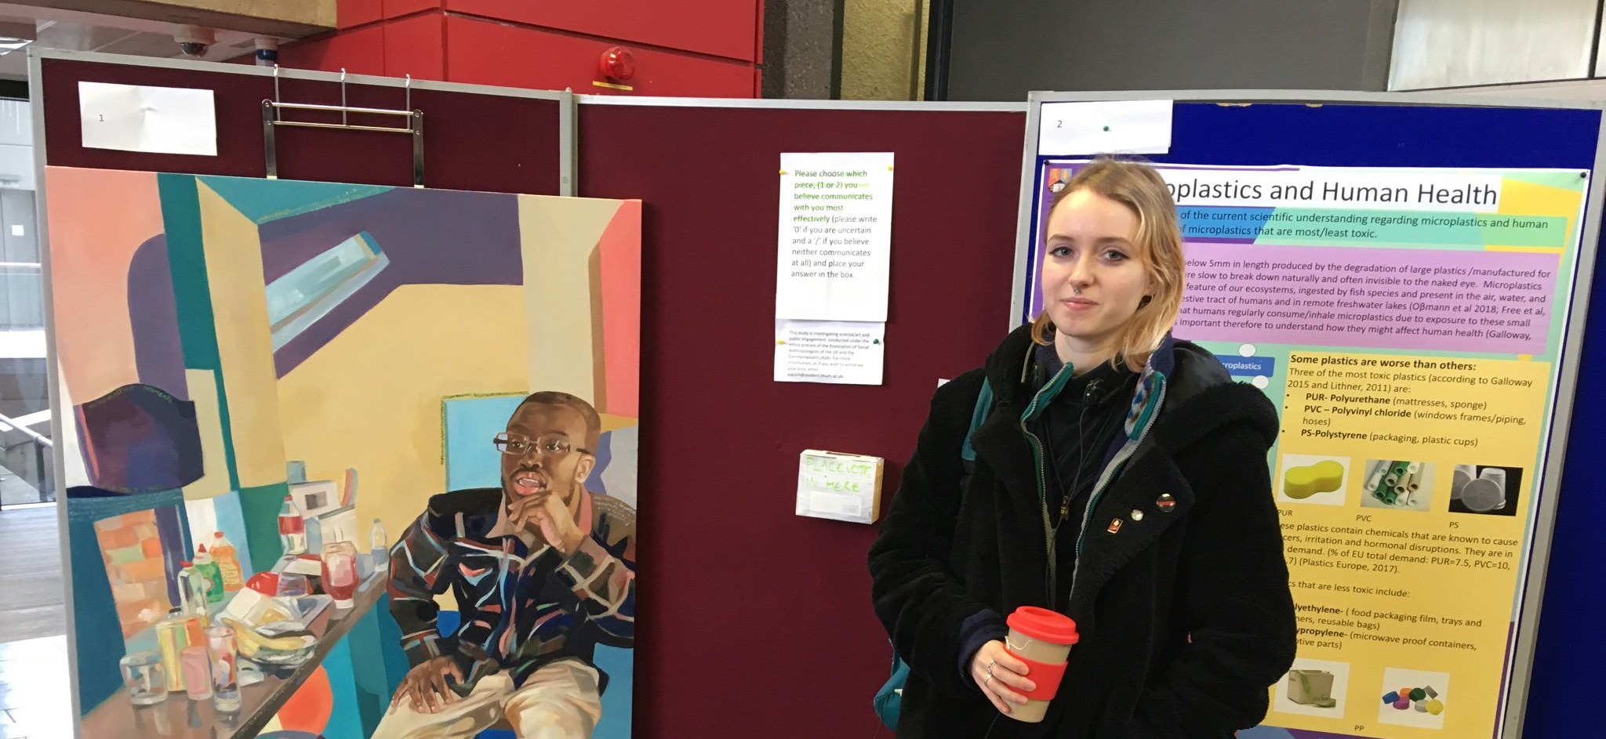
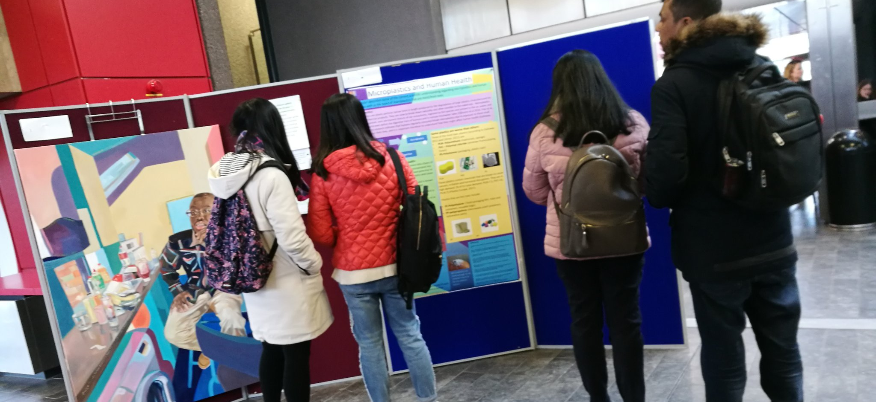
The experiment:
To quantify value of art as a means of communication, I compared a poster and a painting on the same topic: Microplastics and human health.
Randomly selected participants voted for the method that communicated most effectively.
36% preferred the painting
54% preferred the poster

Slide 4
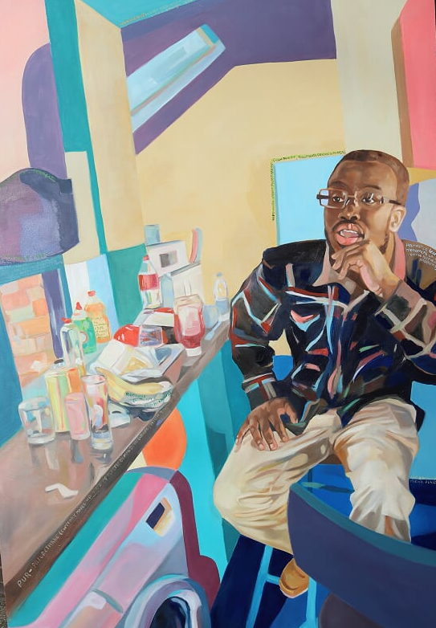
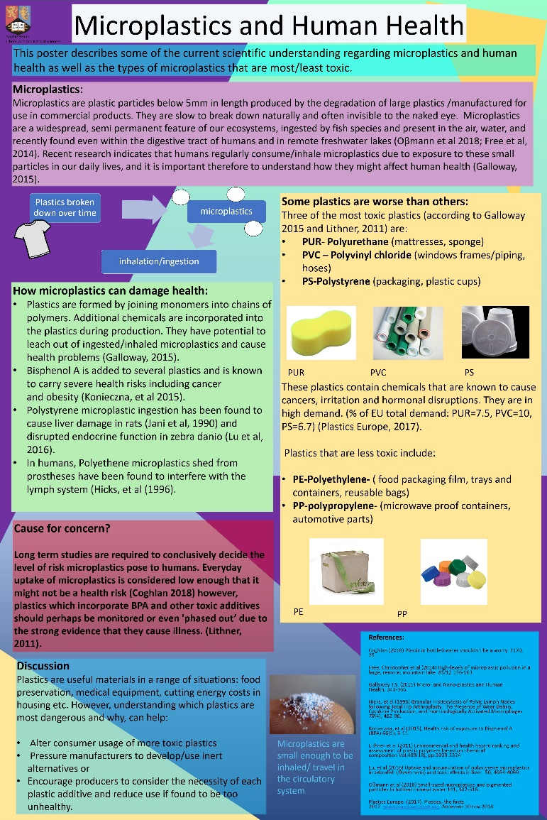
Poster and painting were both approximately 100cm tall and used similar colour theme
*The painting won the Ashurst emerging artist award 2019*

Slide 5

Theories as to why art is 36% preferred communicator:
Facial recognition (Eimer, 2011)
Increased processing
novelty value (park et al 2010)
Group intelligence (different communication methods benefit a whole population than single preferences)
How art works in the brain:
Information processing model
Theories of evolution could help explain the phenomenon.

Slide 6
Results
Understanding why the painting was effective for some people could be key to understanding art and cognition as well as produce better forms of communication.
Next steps for art/science communication:
imagery to describe public health issues, teach science, arguments in favour of arts investments programs.
Collaboration with artists could be helpful to spreading information (as we know from advertising).

Slide 7
Rhizomic/multidisciplinary approach to understanding.
Survey, evolutionary biology, art and biochemistry working together to understand human communication().
Art can be used to communicate and at very least has novelty value and an attention-grabbing capacity ().

Slide 8
References
Eimer, M. (2011). The Face-Sensitive N170 component of the event-related brain potential Oxford Handbook of Face Perception. 430 DOI: 10.1093/oxfordhb/9780199559053.013.0017.
Krause J., Ruxton G.D., & Krause S. (2010). Swarm intelligence in animals and humans Trends in Ecology & Evolution, 25, 28-34.
Park J., Shimojo E. & Shimojo S. (2010). Roles of familiarity and novelty in visual preference judgments are segregated across object categories Proceedings of the National Academy of Sciences, 107, 14552-14555.

